Slide 1
Creating a simple pipeline
Here are the main steps you will perform:
You start the cloud engine.
You create a connection to the database that holds the data at first.
You create an input dataset to read the customer data from the database and two output datasets to write customers that have a valid and invalid state values to other tables.
You create and run your pipeline.

Slide 2
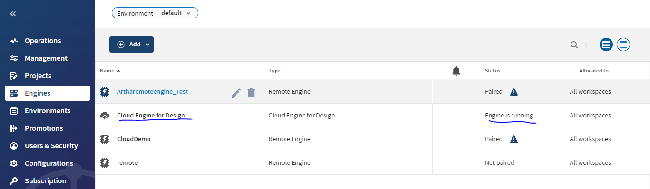
StartiStarting the Cloud Engine the Cloud Engine
#Goto Talend management console
Check the Status of the Cloud Engine for Design.
Click the Engines tab from the left menu.
Check the Cloud Engine for Design status.
In case it is stopped, start it by hovering over Cloud Engine for Design and clicking the Start Cloud Engine for Design button.
The status switches to Engine is starting.
Wait for the status to be updated to Engine is running.

Slide 3
CreatingCreating the connection and the datasets
Using the top menu, select Pipeline Designer.
The home page appears.
The Pipelines tab is open by default on the home page.
A discovery tour may appear. You can follow or just skip it.
Click the Connections tab
Add new connection
Select the engine
Select the connection type
Give the configuration of selected collection

Slide 4
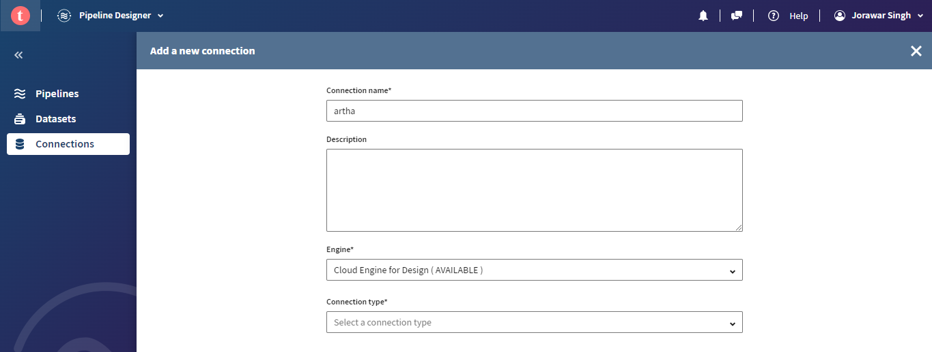

Slide 5
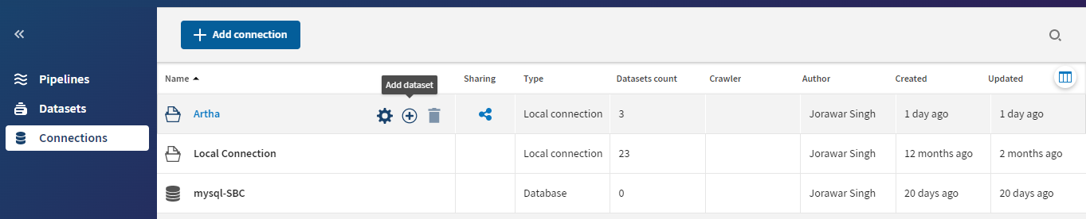
Click on (+) to add the dataset
Or
Directly create the datasets
Create a dataset for source and destination
Click View sample.
Click Validate. You are directed to the dataset information page.

Slide 6
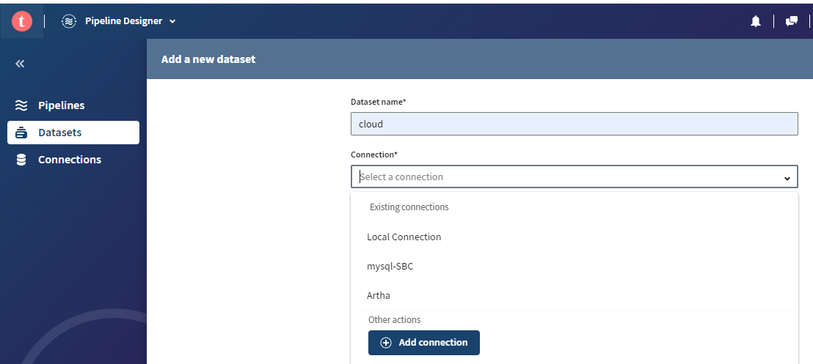

Slide 7
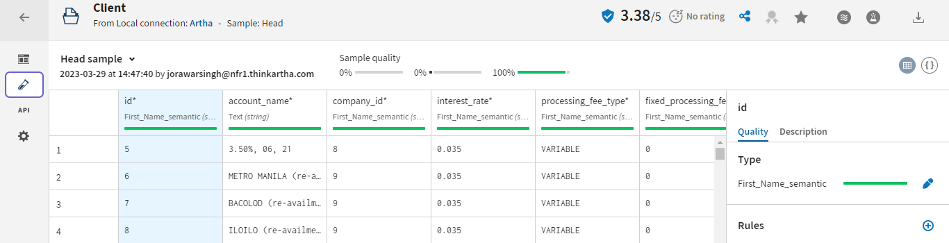
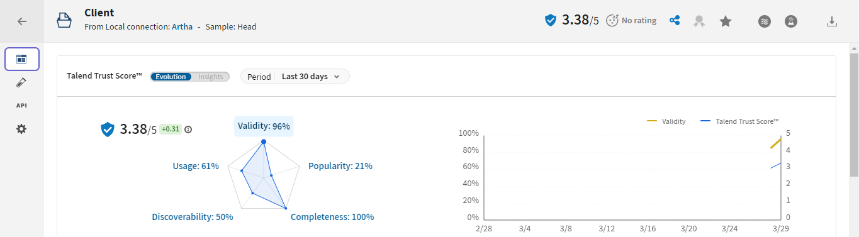

Slide 8
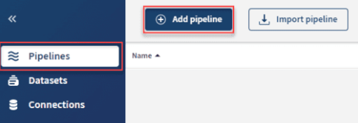
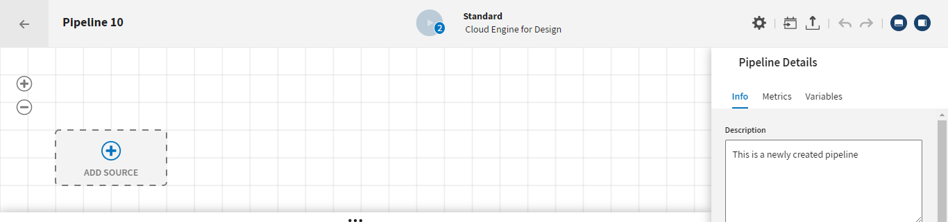
Creating a pipeline
Click the Pipelines tab.
Click the Add pipeline button.

Slide 9
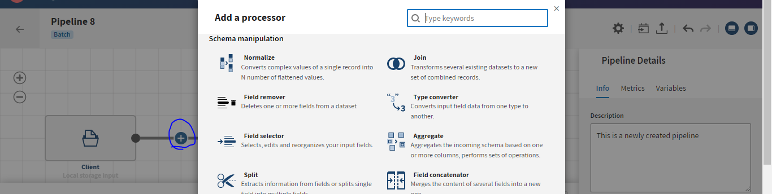
Add a filter processor:
Between the source and destination, click [+].
Complete the configuration whatever the processor we have taken
Add the destination
Click on yellow button of component to add extra component
Run the pipeline

Slide 10
